Slide 1
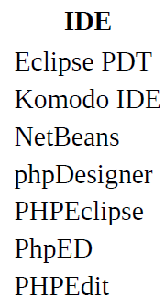

IDE?

Slide 2
PHP - Incorporating PHP Within HTML
By default, PHP documents end with the extension .php
When a web server encounters this extension in a requested file, it automatically passes it to the PHP processor.
Of course, web servers are highly configurable, and some web developers choose to force files ending with .htm or .html to also get parsed by the PHP processor
Usually because they want to hide the fact that they are using PHP.
Your PHP program is responsible for passing back a clean file suitable for display in a web browser.
At its very simplest, a PHP document will output only HTML.

Slide 3
PHP - Incorporating PHP Within HTML
To trigger the PHP commands, you need to learn a new tag
<?php
…
?>
A small PHP “Hello World” program might look like this:
<?php
echo "Hello world";
?>
If you have only PHP code in a file, you may omit the closing ?>

Slide 4
PHP - Incorporating PHP Within HTML
NOTE:
There is a slight variation to the PHP syntax.
If you browse the Internet for PHP examples, you may also encounter code where the opening and closing syntax looks like this:
<?
echo "Hello world";
?>
Although it’s not as obvious that the PHP parser is being called, this is a valid, alternative syntax that also usually works, but should be discouraged, as it is incompatible with XML and its use is now deprecated

Slide 5
PHP - Using Comments
There are two ways in which you can add comments to your PHP code.
The first turns a single line into a comment by preceding it with a pair of forward slashes:
// This is a comment
When you need multiple-line comments, there’s a second type of comment, which looks like this:
<?php
/* This is a section
of multiline comments
which will not be
interpreted */
?>

Slide 6
PHP - Basic Syntax
PHP is quite a simple language with roots in C and Perl, yet it looks more like Java.
In PHP, however, you MUST place a $ in front of all variables.
This is required to make the PHP parser faster, as it instantly knows whenever it comes across a variable.
Whether your variables are numbers, strings, or arrays, they should all look something like those:
<?php
$mycounter = 1;
$mystring = "Hello";
$myarray = array("One", "Two", "Three");
?>
This is required to make the PHP parser faster, as it instantly knows whenever it comes across a variable

Slide 7
PHP - Basic Syntax
Unlike languages such as Python, which are very strict about how you indent and lay out our code, PHP leaves you completely free to use (or not use) all the indenting and spacing you like
Note also that every statement ends with a semicolon
The quotation marks indicate that “Hello” is a string of characters. You must enclose each string in either quotation marks or apostrophes (single quotes), although there is a subtle difference between the two types of quote
<?php
$mycounter = 1;
$mystring = "Hello";
$myarray = array("One", "Two", "Three");
?>

Slide 8
Test Your Might (Cit.)
Your first PHP program
<?php // test1.php
$username = "Donald Duck";
echo $username;
echo "<br>";
$current_user = $username;
echo $current_user;
?>
Now you can call it up by entering the following into your browser’s address bar:
http://localhost/test1.php
Notes:
Or http://localhost:8080/test1.php

Slide 9
PHP - Arrays
This is an array of strings:
$team = array('Bill', 'Mary', 'Mike', 'Chris', 'Anne’);
The array-building code consists of the following construct:
array();
with five strings inside. Each string is enclosed in apostrophes.
If we then wanted to know who player 4 is, we could use this command:
echo $team[3]; // Displays the name Chris

Slide 10
PHP - Arrays
This is a two-dimensional array:
<?php
$oxo = array( array('x', ' ', 'o’),
array('o', 'o', 'x’),
array('x', 'o', ' ‘)
);
?>
To then return the third element in the second row of this array, you would use the following PHP command, which will display an x:
echo $oxo[1][2];
We can support arrays with even more dimensions by simply creating more arrays within arrays

Slide 11
PHP - Variable-naming rules
When creating PHP variables, you must follow these four rules:
Variable names must start with a letter of the alphabet or the _ (underscore) character.
Variable names can contain only the characters a-z, A-Z, 0-9, and _ (underscore).
Variable names may not contain spaces. If a variable must comprise more than one word, it should be separated with the _ (underscore) character (e.g., $user_name)
Variable names are case-sensitive. The variable $High_Score is not the same as the variable $high_score.
Notes:
snake_case

Slide 12
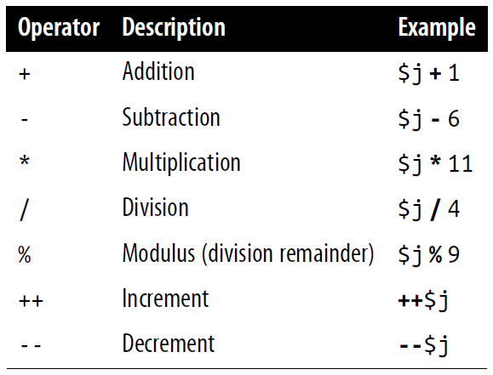
PHP - Arithmetic operators
Arithmetic operators do what you would expect. They are used to perform mathematics.
You can use them for the main four operations (plus, minus, times, and divide) as well as to find a modulus (the remainder after a division) and to increment or decrement a value

Slide 13
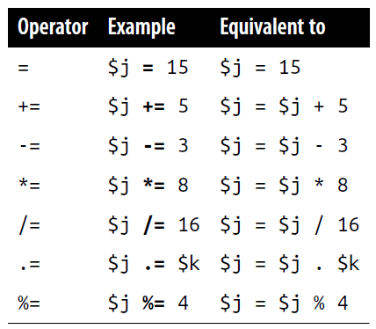
PHP - Assignment operators
These operators are used to assign values to variables. They start with the very simple = and move on to +=, -=, and so on
Thus, if $count starts with the value 5
$count += 1;
sets $count to 6, just like:
$count = $count + 1;

Slide 14
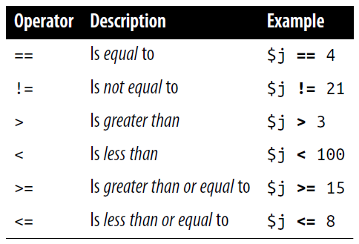
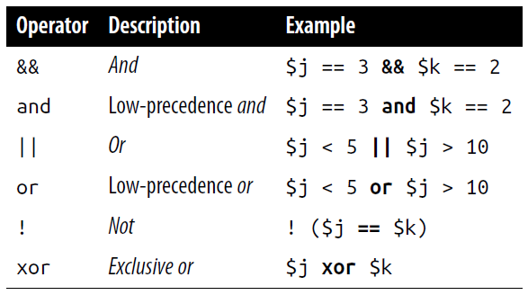
PHP - Comparison and Logical operators
Note that && is usually interchangeable with and; the same is true for || and or. But and and or have a lower precedence, so in some cases, you may need extra parentheses to force the required precedence.
On the other hand, there are times when only and or or are acceptable, as in the following statement, which uses an or operator:
$html = file_get_contents($site) or die("Cannot download from $site");

Slide 15
PHP - Variable incrementing and decrementing
Adding or subtracting 1 is such a common operation that PHP provides special operators for it. You can use one of the following in place of the += and -= operators:
++$x;
--$y;
In conjunction with a test (an if statement), you could use the following code:
if (++$x == 10) echo $x;
This tells PHP to first increment the value of $x and then test whether it has the value 10; if it does, output its value.
But you can also require PHP to increment (or, in the following example, decrement) a variable after it has tested the value, like this:
if ($y-- == 0) echo $y;
Because this combination of statements is confusing, it should be taken as just an educational example and not as a guide to good programming style!

Slide 16
PHP – String Concatenation
String concatenation uses the period (.) to append one string of characters to another. The simplest way to do this is as follows:
echo "You have " . $msgs . " messages.";
Assuming that the variable $msgs is set to the value 5, the output from this line of code will be the following:
You have 5 messages.

Slide 17
PHP – String Concatenation
Just as you can add a value to a numeric variable with the += operator, you can append one string to another using .=, like this:
$bulletin .= $newsflash;
In this case, if $bulletin contains a news bulletin and $newsflash has a news flash, the command appends the news flash to the news bulletin so that $bulletin now comprises both strings of text.

Slide 18
PHP – String Types
PHP supports two types of strings that are denoted by the type of quotation mark that you use.
If you wish to assign a literal string, preserving the exact contents, you should use the single quotation mark (apostrophe), like this:
$info = 'Preface variables with a $ like this: $variable’;
In this case, every character within the single-quoted string is assigned to $info. If you had used double quotes, PHP would have attempted to evaluate $variable as a variable.

Slide 19
PHP – String Types
On the other hand, when you want to include the value of a variable inside a string, you do so by using double-quoted strings:
echo "This week $count people have viewed your profile";
As you will realize, this syntax also offers a simpler form of concatenation in which you don’t need to use a period, or close and reopen quotes, to append one string to another.
This is called variable substitution, and you will notice some applications using it extensively and others not using it at all

Slide 20
PHP – Escaping Characters
$text = 'My spelling's atroshus’; // Erroneous syntax
To correct this, you can add a backslash directly before the offending quotation mark to tell PHP to treat the character literally and not to interpret it:
$text = 'My spelling\'s still atroshus';
Special backslash-preceded characters (such as \t or \n) work only in double-quoted strings.
Within single-quoted strings, only the escaped apostrophe (\') and escaped backslash itself
(\\) are recognized as escaped characters.

Slide 21
PHP – Multiple-Line Commands
There are times when you need to output quite a lot of text from PHP, and using several echo (or print) statements would be time-consuming and messy.
To overcome this, PHP offers two conveniences.
The first is just to put multiple lines between quotes:
<?php
$author = "Steve Ballmer";
echo "Developers, Developers, developers, developers,
developers, developers, developers, developers!
- $author.";
?>
<?php
$author = "Bill Gates";
$text = "Measuring programming progress by lines of code
is like measuring aircraft building progress by weight.
- $author.";
?>

Slide 22
PHP – Multiple-Line Commands
PHP also offers a multiline sequence using the <<< operator—commonly referred to as a here-document or heredoc—as a way of specifying a string literal, preserving the line breaks and other whitespace in the text.
<?php
$author = "Brian W. Kernighan";
echo <<<_END
Debugging is twice as hard as writing the code in the first place.
Therefore, if you write the code as cleverly as possible, you are,
by definition, not smart enough to debug it.
- $author.
_END;
?>
Notes:
By the way, all browsers treat newlines just like spaces

Slide 23
PHP – Multiple-Line Commands
Quotes in a heredoc do not need to be escaped.
This means it’s possible, for example, for a developer to write entire sections of HTML directly into PHP code
<?php
$author = "Brian W. Kernighan";
echo <<<_END
Debugging is twice as hard as writing the code in the first place.
Therefore, if you write the code as cleverly as possible, you are,
by definition, not smart enough to debug it.
- $author.
_END;
?>
It is important to remember that the closing _END; tag must appear right at the start of a new line and it must be the only thing on that line—not even a comment is allowed to be added after it. Not even a single space!

Slide 24
PHP – Multiple-Line Commands
By the way, the _END tag is simply one I chose for these examples.
But you can use any tag you like, such as _SECTION1 or _OUTPUT and so on.
<?php
$author = "Brian W. Kernighan";
echo <<<_END
Debugging is twice as hard as writing the code in the first place.
Therefore, if you write the code as cleverly as possible, you are,
by definition, not smart enough to debug it.
- $author.
_END;
?>
Notes:
Also, to help differentiate tags such as this from variables or functions, the general practice is to preface them with an underscore, but you don’t have to use one if you choose not to.

Slide 25
PHP – Multiple-Line Commands
PHP is a very loosely typed language
This means that variables do not have to be declared before they are used, and that PHP always converts variables to the type required by their context when they are accessed

Slide 26
PHP – Variable Typing
<?php
$number = 12345 * 67890;
echo substr($number, 3, 1);
?>
What’s wrong whit this code?

Slide 27
PHP – Variable Typing
Automatic conversion from a number to a string
<?php
$number = 12345 * 67890;
echo substr($number, 3, 1);
?>
At the point of the assignment, $number is a numeric variable.
But later, a call is placed to the PHP function substr, which asks for one character to be returned from $number, starting at the fourth position (remembering that PHP offsets start from zero).
To do this, PHP turns $number into a nine-character string, so that substr can access it and return the character, which in this case is 1

Slide 28
PHP – Variable Typing
Automatically converting a string to a number
<?php
$pi = "3.1415927";
$radius = 5;
echo $pi * ($radius * $radius);
?>
In practice, what this all means is that you don’t have to worry too much about your variable types.
Just assign them values that make sense to you, and PHP will convert them if necessary

Slide 29
PHP – Constants
One example of a use for a constant is to hold the location of your server root (the folder with the main files of your website). You would define such a constant like this:
define("ROOT_LOCATION", "/usr/local/www/");
Then, to read the contents of the variable, you just refer to it like a regular variable (but it isn’t preceded by a dollar sign):
$directory = ROOT_LOCATION;
Now, whenever you need to run your PHP code on a different server with a different folder configuration, you have only a single line of code to change.
It is generally considered a good practice to use only uppercase for constant variable names

Slide 30
PHP – Magic Constants
PHP comes ready-made with dozens of predefined constants that you generally will be unlikely to use as a beginner to PHP.
However, there are a few—known as the magic constants—that you will find useful.
The names of the magic constants always have two underscores at the beginning and two at the end, so that you won’t accidentally try to name one of your own constants with a name that is already taken

Slide 31
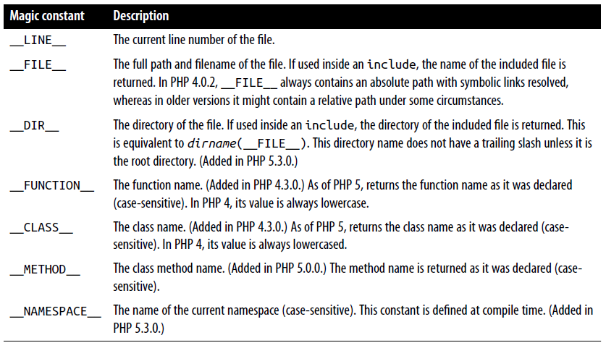
PHP – Magic Constants

Slide 32
PHP – Magic Constants
Example: One handy use of these variables is for debugging purposes, when you need to insert a line of code to see whether the program flow reaches it:
echo "This is line " . __LINE__ . " of file " . __FILE__;
This causes the current program line in the current file (including the path) being executed to be output to the web browser.

Slide 33
PHP – echo vs print Commands
There is also an alternative to echo that you can use: print
print is a “function-like construct” that takes a single parameter and has a return value (which is always 1)
echo is purely a PHP language construct.
Note: Since both commands are constructs, neither requires parentheses
The echo command will be a bit faster than print in general text output, because it doesn’t set a return value.
On the other hand, because it isn’t implemented like a function, echo cannot be used as part of a more complex expression, whereas print can

Slide 34
PHP – echo vs print Commands
Here’s an example to output whether the value of a variable is TRUE or FALSE using print, something you could not perform in the same manner with echo, because it would display a Parse error message:
$b ? print "TRUE" : print "FALSE";

